Slide 1
The Field of Data Science
Business Intelligence
Shahriar’s Analytical Academy

Slide 2
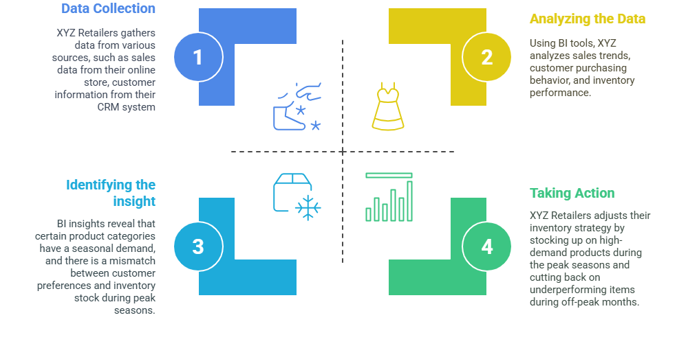
Definition and Example
Business Intelligence (BI) refers to the technologies, practices, and tools used to collect, analyze, and present business data to support better decision-making. BI helps organizations make data-driven decisions by turning raw data into meaningful insights.
Notes:
Business Intelligence (BI) is a set of tools, practices, and technologies that help businesses gather, analyze, and present data to make better decisions. In simple terms, BI helps companies understand the information they have, like sales or customer data, so they can make smarter choices based on facts, not just guesses. It turns complex data into clear insights that guide businesses in the right direction, helping them to grow and improve.
Example Scenario:
Imagine a retail company that wants to boost its sales. To do this, it needs to understand how customers shop. With BI tools, the company can look at data like who its customers are, what they buy, and when they tend to shop. For example, the company might discover that customers buy more winter clothes in the fall or around certain holidays. This kind of insight allows the company to plan better.
With this information, the company can stock more winter clothes before the season starts and run special promotions during the holiday period. They can also send targeted ads to customers who are most likely to buy these items. As a result, the company can make smarter decisions, sell more products, and ultimately increase their profits. BI tools help the company take action based on real data, which is more reliable than just guessing what might work.

Slide 3
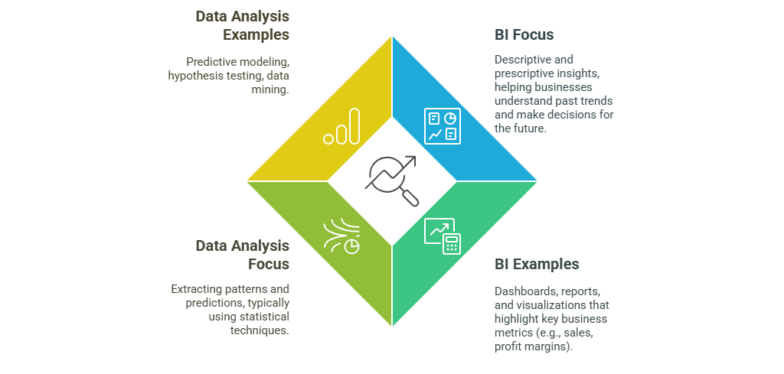
Data Analysis
v/s
Business Intelligence
Notes:
Business Intelligence (BI) is focused on understanding what has happened in the past and using that information to make better decisions for the future. It helps businesses track and analyze their key performance indicators (KPIs), such as sales and profits, to improve their overall performance. BI is about summarizing past data in easy-to-understand formats, so businesses can see trends and patterns.
Examples of BI tools include dashboards, reports, and visualizations. These tools show important business metrics like total sales, profit margins, and customer trends. For instance, a BI dashboard might show how sales have been growing over the past few months, which can help managers make decisions about inventory or marketing strategies.
Data Analysis, on the other hand, is more about looking closely at data to find patterns, trends, and make predictions. It uses statistical techniques and methods to understand data more deeply. The goal is to extract useful information that helps to predict future outcomes or test specific hypotheses.
Examples of data analysis include methods like predictive modeling, hypothesis testing, and data mining. Predictive modeling, for example, is used to forecast future trends, such as predicting which products will be in high demand next season based on past buying patterns. Data analysis goes beyond just summarizing data—it looks for deeper insights that can lead to more specific conclusions and forecasts.

Slide 4
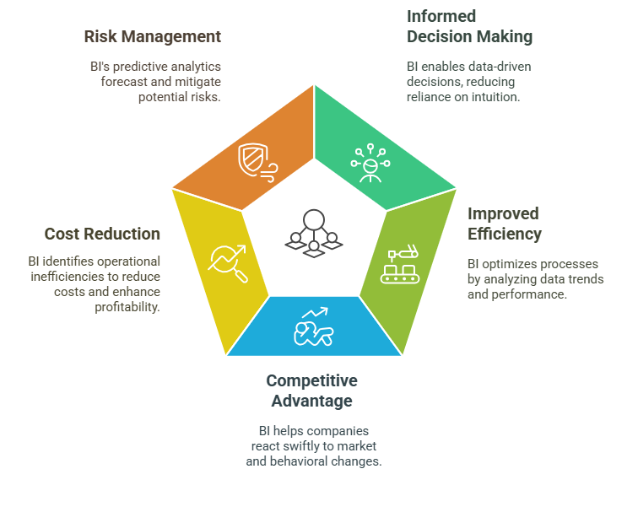
Importance of
Business Intelligence
Notes:
Informed Decision Making: One of the most important benefits of Business Intelligence (BI) is that it allows managers to make decisions based on data rather than relying on intuition or guesswork. For example, if a manager is deciding which products to stock up on for the next season, BI tools can provide data on previous sales patterns, customer preferences, and market trends. This helps managers make decisions that are grounded in facts, which leads to better outcomes and reduces the risk of mistakes.
Improved Efficiency: BI helps businesses run more efficiently by analyzing data trends and performance metrics. By identifying areas where operations can be streamlined or improved, businesses can optimize their processes. For instance, if a manufacturing company notices through BI analysis that certain steps in production take longer than expected, they can make adjustments to speed up the process, saving both time and money.
Competitive Advantage: In today’s fast-paced market, staying ahead of competitors is crucial. BI enables companies to quickly react to changes in the market, customer behavior, and operational performance. For example, if a company notices a sudden shift in customer preferences, they can adjust their marketing or product offerings right away. This ability to respond quickly gives them a competitive edge over businesses that rely on slower, manual decision-making.
Cost Reduction: BI tools can also help businesses identify inefficiencies in their operations or supply chains, leading to cost savings. For instance, by analyzing inventory data, a company may find that they are overstocking certain products, tying up unnecessary resources. With this insight, they can adjust their inventory strategy, reducing costs while maintaining sales efficiency. BI helps businesses find areas where they can save money and increase profitability.
Risk Management: Another key advantage of BI is its ability to predict and manage risks. Through predictive analytics, businesses can forecast potential challenges or threats before they occur. For example, a company may use BI to predict that a certain product may face supply chain delays, allowing them to take proactive measures to avoid or minimize the impact of that risk. This foresight helps companies mitigate problems and protect their bottom line.

Slide 5
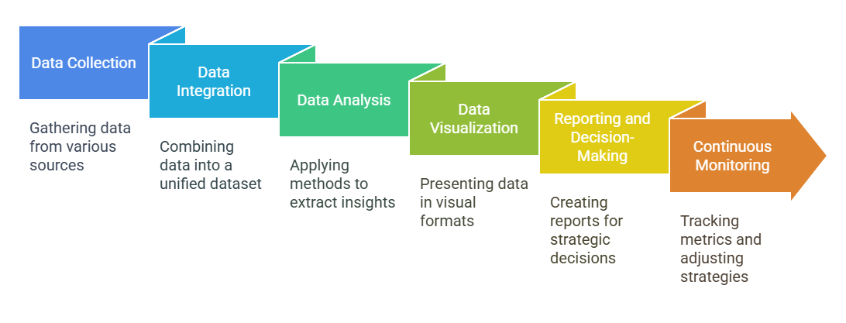
Steps in Business Intelligence
Notes:
Data Collection: The first step in Business Intelligence (BI) is to gather data from various internal and external sources. This can include data from company databases, spreadsheets, customer records, and even social media platforms. For example, a retail business may collect data from their point of sale system, customer feedback surveys, and social media to understand what products are popular and what customers are saying about them. Gathering this data is essential as it forms the foundation for the next steps in the BI process.
Data Integration: Once the data is collected, the next step is to combine it from different sources into a unified dataset. This is done through the ETL process: Extract, Transform, Load. Extracting data means pulling it from different sources, transforming it means cleaning and organizing it (for example, making sure all customer names are formatted consistently), and then loading it into a central database or data warehouse for further analysis. This step ensures that the data is ready and accessible for analysis, making it easier to spot patterns or trends.
Data Analysis: After the data is integrated, it’s time to analyze it. This involves applying statistical methods, algorithms, or machine learning models to uncover patterns, trends, or insights that can help inform decisions. For example, a company might use data analysis to identify which products are selling the most or which customer segments are most profitable. The goal of this step is to turn raw data into meaningful information that can guide business strategies.
Data Visualization: Once the data has been analyzed, the next step is to present it in a way that is easy to understand. Data visualization involves using charts, graphs, and dashboards to visually represent the data, helping business users interpret it quickly. For instance, a company might use a bar chart to show sales performance over time, or a pie chart to show the breakdown of customer demographics. Data visualizations make complex data more accessible, helping decision-makers see trends and patterns at a glance.
Reporting and Decision-Making: Based on the data analysis and visualizations, BI tools help create actionable reports or dashboards. These reports highlight the key insights that are most relevant for making business decisions. For example, a report might show that a particular marketing campaign is leading to higher sales in certain regions, prompting the company to allocate more resources to that campaign. These reports guide strategic decisions, helping businesses stay on track to meet their goals.
Continuous Monitoring: The final step in the BI process is continuous monitoring. Businesses need to track their key performance indicators (KPIs) and metrics regularly to ensure that their strategies are still effective. If new data shows that performance is declining or trends are changing, adjustments can be made. For example, a company might monitor its sales data regularly and make quick changes to inventory or marketing strategies if the data shows a drop in sales. Continuous monitoring ensures that businesses stay agile and can make data-driven decisions in real time.

Slide 6
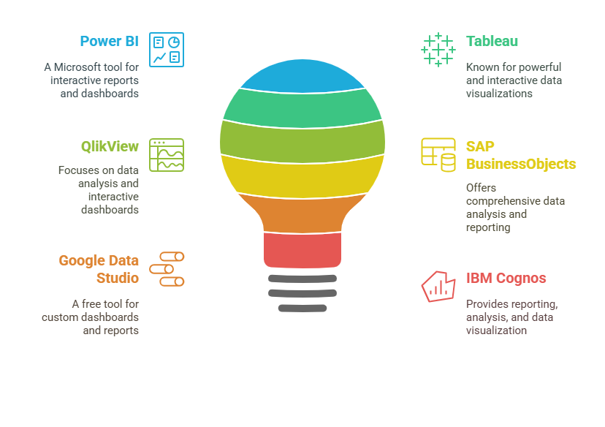
Tools of
Business Intelligence
Notes:
Power BI: Power BI is a Microsoft tool that helps businesses turn their data into interactive reports and dashboards. It allows users to easily create visualizations and share them with others in the organization. For example, a company might use Power BI to display sales data in a dashboard, where different team members can access up-to-date insights on performance. Power BI integrates well with other Microsoft tools like Excel and Azure, making it a popular choice for businesses already using Microsoft products.
Tableau: Tableau is a well-known data visualization tool that is recognized for its ability to create powerful and interactive visualizations. It allows users to create detailed charts, graphs, and dashboards that help to make complex data easier to understand. For instance, a retail company might use Tableau to display product sales data across different regions, making it easier for managers to identify trends. Tableau is highly flexible and allows users to drill down into the data for deeper insights.
QlikView: QlikView is a BI tool designed for data analysis and creating interactive dashboards. It allows users to explore data freely and visually through its in-memory processing capabilities, making it easier to find insights. For example, a business might use QlikView to create an interactive dashboard that allows executives to explore sales, customer feedback, and inventory data all in one place. It helps organizations make data-driven decisions by providing flexible analysis tools.
SAP BusinessObjects: SAP BusinessObjects is a suite of BI tools that provides comprehensive data analysis, reporting, and visualization features. It is commonly used in large organizations to manage and analyze large datasets. For example, a company might use SAP BusinessObjects to generate detailed financial reports or analyze supply chain performance. Its integration with other SAP enterprise solutions makes it a go-to tool for businesses using SAP software.
Google Data Studio: Google Data Studio is a free BI tool that allows users to create custom dashboards and reports. It integrates with other Google services like Google Analytics, Google Sheets, and Google Ads, making it a great choice for businesses that rely on Google’s ecosystem. For instance, a small business might use Google Data Studio to create a dashboard that tracks website traffic, customer behavior, and ad performance, all in one place.
IBM Cognos: IBM Cognos is a suite of BI tools designed for reporting, analysis, and data visualization. It helps businesses track and manage performance with a wide range of features, from basic reporting to advanced data modeling. For example, a business might use IBM Cognos to create executive-level performance reports or analyze key operational metrics. IBM Cognos is known for its scalability, making it suitable for businesses of all sizes.

Slide 7
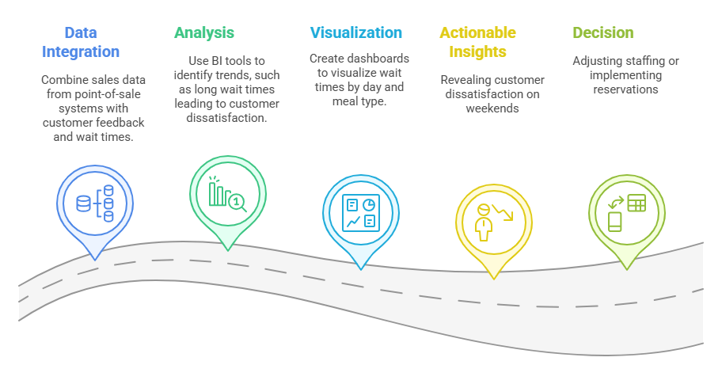
How to find insight from scenario example
Scenario: A restaurant chain wants to increase customer satisfaction and profitability.
Data: The restaurant collects data on customer reviews, food preferences, wait times, and sales.
Notes:
Scenario: A restaurant chain wants to increase customer satisfaction and profitability.
Data: The restaurant collects a variety of data, including customer reviews, food preferences, wait times, and sales. This data gives insight into how customers experience the service and what they like or dislike about the food.
BI Approach:
Data Integration: The first step in the BI approach is to combine different sets of data. In this case, the restaurant can merge sales data from its point-of-sale (POS) systems with customer feedback and wait times. By integrating all this information into one dataset, the restaurant can get a clearer picture of its operations. For example, sales data might show peak hours, while wait times data helps show when customers are getting frustrated.
Analysis: Once the data is integrated, BI tools can be used to analyze it and identify trends. In this case, the analysis might reveal that long wait times are often linked to customer dissatisfaction. By examining when wait times are highest—perhaps during busy weekend hours—the restaurant can start to identify specific patterns. For instance, BI tools may show that customers are most unhappy with their experience during peak dinner hours on Fridays and Saturdays.
Visualization: To make the data easier to understand, the restaurant can create visualizations using BI tools. Dashboards can be designed to show wait times by day of the week and by meal type. This helps the management team easily see which days or times are causing the most delays. For example, the dashboard might show that Friday evenings have the longest wait times, or that certain meal types (e.g., steaks) take longer to prepare.
Actionable Insights: The analysis and visualization provide actionable insights. The restaurant may discover that customer dissatisfaction is most pronounced on weekends, due to long wait times during peak hours. This information gives the restaurant a clear area to focus on in order to improve the customer experience.
Decision: Based on these insights, the restaurant can make strategic decisions to improve customer satisfaction. For example, they could adjust staffing schedules to ensure more staff are available during peak hours. Alternatively, the restaurant could implement a reservation system, allowing customers to book a table in advance, which could help manage wait times. By reducing wait times, customer satisfaction would improve, leading to increased repeat business and, ultimately, higher profitability.

Slide 8
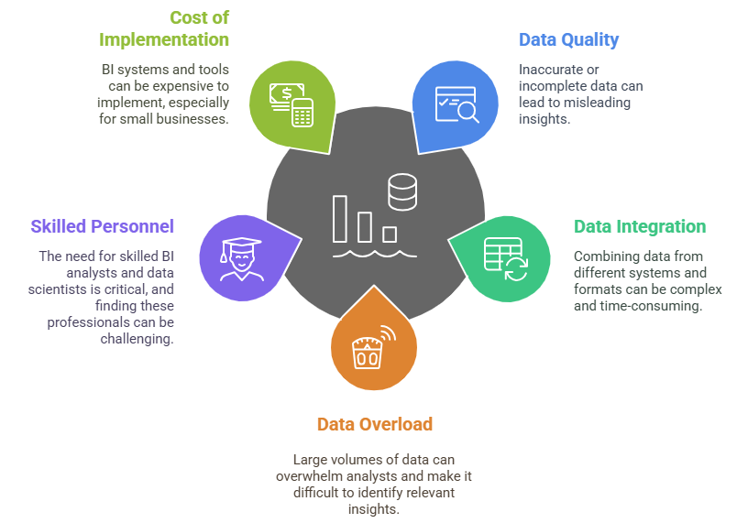
Challenges in
Business Intelligence
Notes:
Data Quality: One of the main challenges in Business Intelligence (BI) is ensuring the quality of the data. If the data is inaccurate, incomplete, or outdated, it can lead to misleading insights and poor decision-making. For example, if a company is using faulty sales data to make inventory decisions, they might overstock items that aren't selling well, or worse, understock popular products. Therefore, it’s crucial to ensure that data is clean, accurate, and up-to-date to make reliable business decisions.
Data Integration: Another challenge in BI is integrating data from different sources. Businesses often collect data from various systems—like customer relationship management (CRM) tools, sales platforms, or social media analytics—and these systems may use different formats or structures. Combining this data into a unified dataset can be complex and time-consuming. For example, a company that uses separate systems for online and in-store sales may struggle to integrate both sets of data, making it harder to get a complete view of customer behavior.
Data Overload: As businesses gather more data, the sheer volume of information can become overwhelming. Analysts may struggle to sort through large datasets to find meaningful insights, which can delay decision-making. For instance, if a business collects data from multiple channels (website traffic, customer reviews, social media), they may face a flood of information that makes it difficult to focus on the most important patterns or trends. Without the right tools and processes, this data overload can lead to confusion rather than clarity.
Lack of Skilled Personnel: A significant challenge in implementing BI is finding skilled personnel who can analyze and interpret the data effectively. BI relies on professionals like BI analysts, data scientists, and engineers, who are trained in both business and technical aspects of data analysis. Unfortunately, skilled personnel are in high demand, and many companies find it challenging to hire and retain these professionals. A lack of skilled personnel can limit a company's ability to fully leverage BI tools and make informed decisions based on data.
Cost of Implementation: Implementing Business Intelligence systems and tools can be costly, especially for small businesses with limited budgets. BI software, along with the infrastructure and expertise required to use it effectively, can come with significant upfront and ongoing costs. Small businesses may struggle to justify the investment in BI tools, especially when they may not yet have the resources to hire data professionals or invest in expensive software. The cost of implementation can be a major barrier for companies that want to use BI but cannot afford the necessary tools or training.

Slide 9
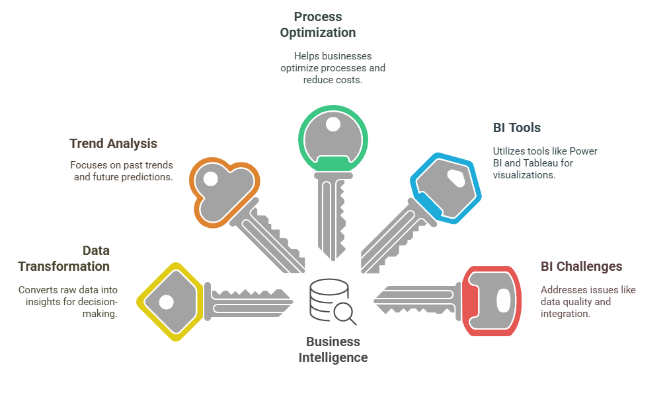
5 Key Learning Points of this Lesson
Notes:
Here are the 5 key learning points from the lesson:
Business Intelligence (BI) plays a crucial role in turning raw, unorganized data into valuable information that can drive business decisions. By analyzing historical data and identifying trends, BI helps businesses make informed choices that improve overall performance and guide strategic decisions.
BI focuses on understanding past trends and predicting future outcomes, helping businesses understand what has happened and what might happen. In contrast, data analysis goes deeper by extracting patterns and using statistical techniques to provide specific insights and forecasts. BI provides a broader view, while data analysis often focuses on in-depth exploration of data.
BI enables businesses to improve operational efficiency by analyzing data to identify inefficiencies. It helps optimize processes, reduce unnecessary costs, and enhance profitability. By leveraging data, businesses can stay ahead of competitors and adapt quickly to changes in the market, giving them a significant edge.
Tools like Power BI, Tableau, and SAP BusinessObjects are essential for analyzing data, creating visualizations, and generating actionable reports. These BI tools allow businesses to transform complex data into easy-to-understand charts, graphs, and dashboards, which provide valuable insights for decision-makers.
Businesses face several challenges when implementing BI, including ensuring data quality, integrating data from various sources, and the high costs associated with BI systems. Additionally, the need for skilled personnel, such as BI analysts and data scientists, is critical for success. Security concerns around data handling and privacy are also important issues businesses must address when using BI.

Slide 10
Thank You!
Shahriar’s Analytical Academy

